Slide 1
Welcome to Class 1 Presentation Autumn 23

Slide 2
Welcome to Class 1
Teacher – Mrs Errington
Teaching Assistants –
Mrs Paterson (Everyday)
Sarah (Monday, Wednesday and Thursday)
Miss Dobson (Tuesday)
Mrs Cave (Friday AM)

Slide 3
Class 1 Ethos
Our ethos is for learning to be fun, active, imaginative, challenging and inspiring. This is incorporated in a wide range of practical, outdoor, creative, play-based activities.
The important transition from the Early Years curriculum to the Key Stage One curriculum is well catered for, giving the children opportunities to carry on learning through play.
The transition experience for all of our children is carefully considered so that they have the best opportunities as they move into the next stage of school life!

Slide 4
Christian Values
In Class One we follow our school Christian Values:
• Respect
• Truth
• Kindness
• Forgiveness
• Thankfulness

Slide 5
Rewards
We focus on promoting positive behaviour for learning and want to recognise all of the fantastic things the children do. The following are the reward systems we use in class:
Daily
Star Chart (please see following slide for the rewards available for stars)
Raffle ticket in the Super Star box (name picked out Friday-prize chosen)
Weekly
Celebration worship
Golden book –celebrating Christian values
Golden time- whole class
Positive note home

Slide 6
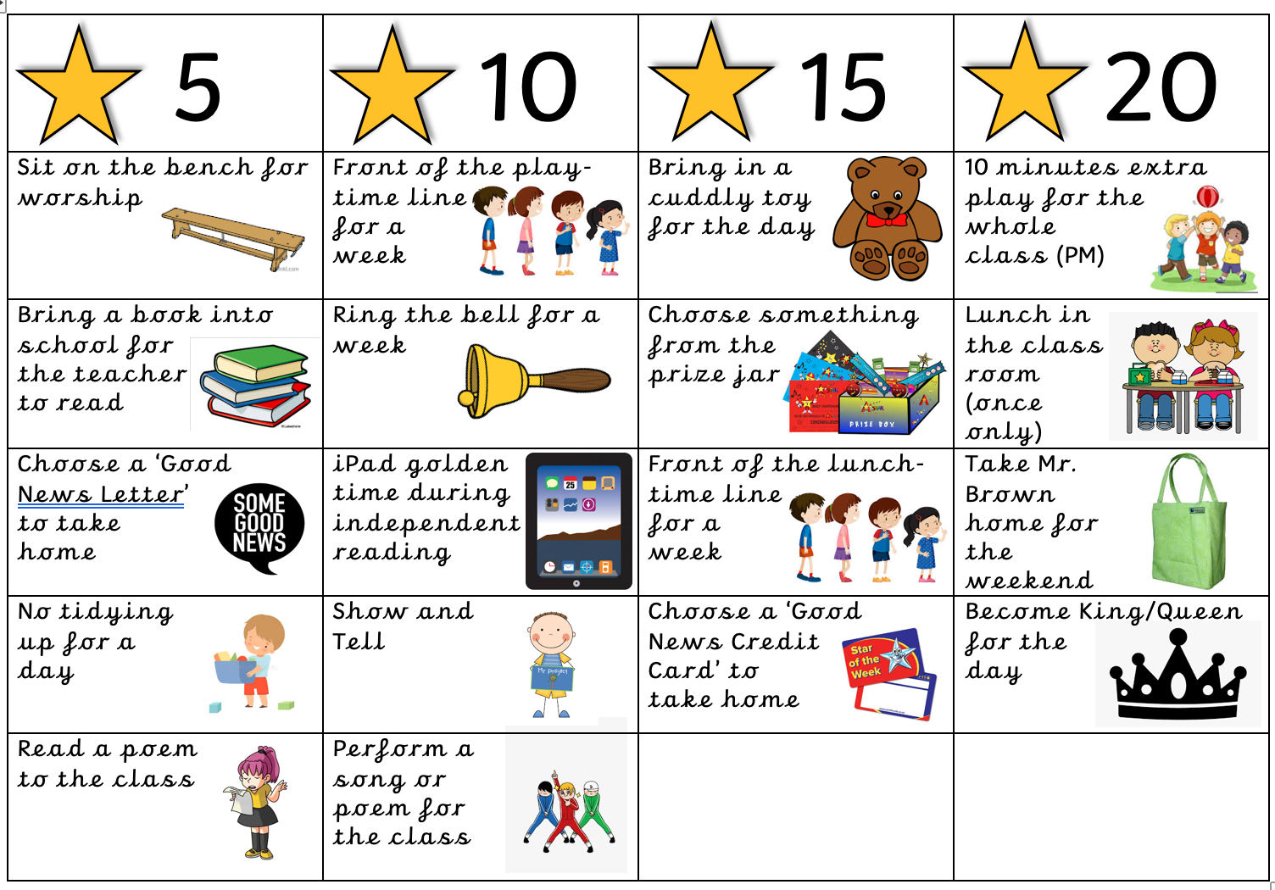
Star Rewards Chart Star rewards can change throughout the year following discussions with the children.

Slide 7
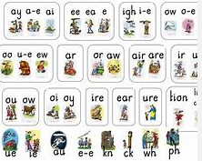
Phonics
Phonics will be taught each morning from 9:10am – 9:30am and will be taught using the Read Write Inc Scheme.
Children have been split into 4 groups after taking into consideration their year group and importantly their end of year teacher assessment result from July 2023 and the most recent Read Write Inc assessment.
Each group will work through the appropriate phonics phases at a pace and in a teaching style appropriate to that group.
Please refer to the “useful websites and documents to support” page for an overview of the phonics phases and what is taught within each. Set 1 has already been taught in Reception and they have also been introduced to some of the Set 2 sounds.

Slide 8
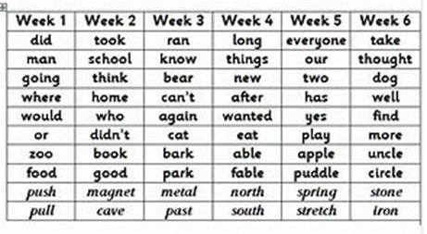
Weekly Spellings Year 2 only
Your child will receive a set of spellings to learn each Friday on a Look, Cover, Write, Check sheet. They will have a spelling assessment of those words the following Friday. Please ensure your child has their spelling folder with them each Friday so we can give them their new spelling sheet.
The spelling rule for that week is taught in school. They have:
20 - 30 minutes to work on their Weekly Spellings in preparation for the Spelling quiz on a Friday.
20 - 30 minutes to work on the Common Exception Words for their year group (words which they are expected to read and spell by the end of the year that do not follow traditional phonetic spelling patterns) or 100 Key Stage 1 High Frequency Words. (A copy of these are at the back of the reading scrapbook).

Slide 9
PE and Forest School
Class one have PE on a Thursday afternoon with Mr Thompson.
Please make sure children have labelled PE kits including their shoes. They need shorts, a t-shirt and plimsolls. The kit should stay in school.
Please can they also have named tracksuit bottoms/ leggings for outside PE as most of our lessons are outdoors. So please make sure your child is dressed appropriately and has the correct kit at all times.
Forest School
Autumn Term – Class 1 will take part in Forest School every Friday afternoon.

Slide 10
Helping at home
We strongly believe at Broomhaugh that a strong home-school connection will set the stage for a child who will grow up with a love for learning. When parents and teachers work well together, everyone benefits. Parents and teachers can provide each other with unique insight and different perspectives about the child, culminating a complete understanding of that child, their abilities, strengths, and challenges.
So how can you help…?
Further information on the next slides…

Slide 11
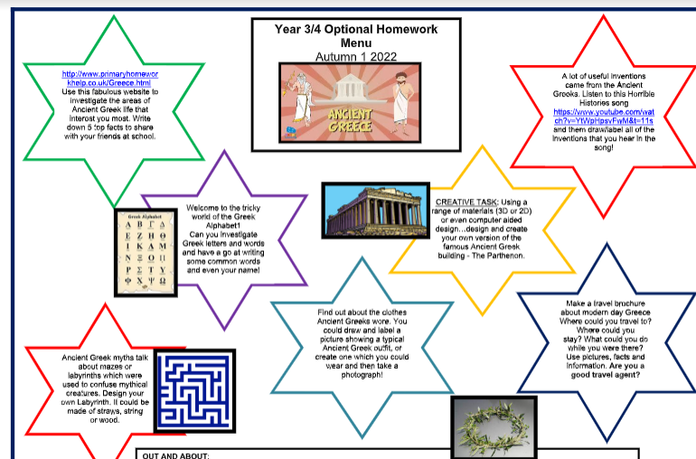
Homework
Each child will been given an homework book and within this is an optional homework menu. They are given a menu every half term. Your child will receive a star for each piece of optional homework they complete during that half term and it will be acknowledged and celebrated in school.
If you child has completed a piece of optional homework they should bring their homework book into school on a Wednesday. On Wednesdays we have an allocated time to discuss and celebrate any homework completed.

Slide 12
Reading at home
We love to read and promoting a love of reading is at the heart of our school, it underpins so many areas of learning and helps all children to access and develop so many other skills. We want to work closely with all of our families to ensure this continues at home. We want all of our children to engage and experience a wide range of texts including fiction, non fiction, newspapers, magazines, e-books etc.
Reading books can be changed on a Monday each week. If you child has finished their reading book, they should put it in our reading book box and we will change it on one of the allocated days. Books should be read a number of times to increase the children’s fluency when reading and you should ask your child questions about what they have read. Becoming a competent reader requires good understanding as well as simply being able to decode the text or read the words. We want to foster a love of ‘reading for meaning and enjoyment’.
The children will be read with at least twice a week – once during Guided Reading and they will have one additional reading slot. Please ensure your child's reading book is in their book bag everyday so we can read with them.
Please support your child to read every night. Whilst many children are confident readers already, reading aloud is an important skill to practise and sharing books and stories, discussing characters, plots and facts are all important parts of developing a good understanding of reading as well as the technical skills, not to mention sharing books together is a lovely thing to do. Don't forget to read to your child too, this helps to model expression and listening to others reading is also a really fun and useful things to do.
We will use an assessment of their comprehension to decide whether they are ready to progress to the next book band colour in our scheme.

Slide 13
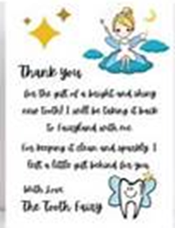
Reading Scrapbook
Please write a comment in the scrapbook to celebrate your child’s reading.
Pictures (from the internet) or drawings of authors of good books they have read
• Pictorial or written book reviews made when a book is finished
• Photos of children visiting any place that features print
• Drawings of characters from books
• Free book marks you get from book shops
• Drawings of front covers of favourite books from home
• Pictures of library visits
• Letters/emails received that involve your child e.g. from a family member or the
tooth fairy!
• Copies of illustrations from books
• When your child has enjoyed listening to a bedtime story and can talk about it they could record this in their book.

Slide 14
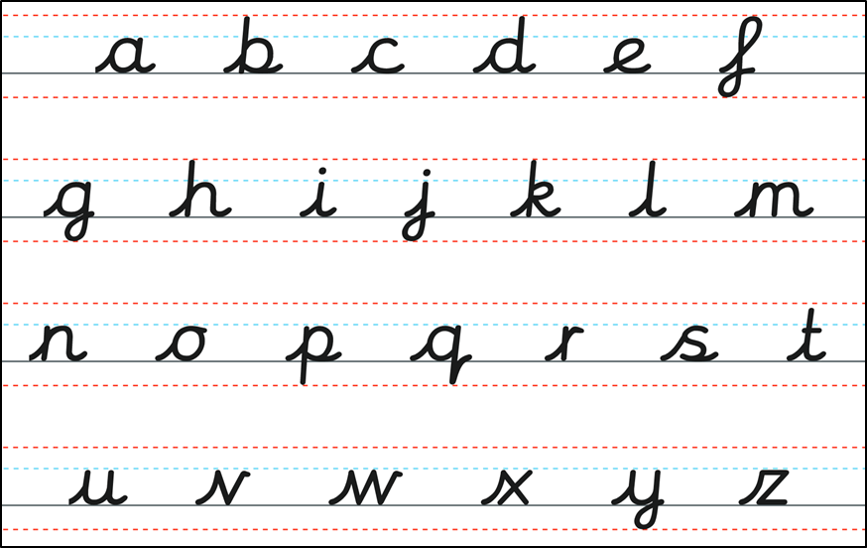
Handwriting
Year 1
Practice forming letters correctly, the correct size and also positioning them on the line.
Year 2
Encourage your child to write in the pre-cursive style being taught in class. The pre-cursive alphabet is below for your reference. Those children who have mastered this will then be encouraged to fully join!

Slide 15
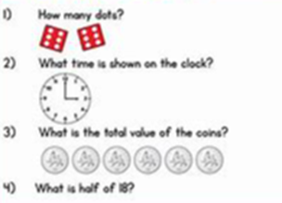
Maths
Practise number formation (children can struggle to form them the correct way)
Practise counting back and forwards in 10’s, 5’s, 2’s and eventually 3’s and 4’s and then times tables! Times Tables Blast is fabulous too (within Resources/J2E on School 360).
White Rose 1 minute maths (iPad app)
Reading the time to the nearest hour/ half hour in Year 1 and to the nearest 5 minutes in Year 2.
Count money
Number problems: “You have 20 sweets and I have 11. How many altogether?”

Slide 16
School Website
Please check our school website regularly for:
Diary Dates
Calendar
Year 1/2 page including Curriculum Overview
Timetable
Photo Galleries
Thrive, mental health and well-being
Newsletters
Staff and Governor information
E-Safety information
Policies …. and lots more!

Slide 17
School Office
Please contact the school office for any of the following:
Squirrels information, booking requests, cancellations, cash/cheque payment and billing related queries.
Medical updates for your child, changes to medication, short-term medication arrangements.
Medical/dental appointments for your child that are during the school day.
Reporting an absence Changes to pick-up arrangements
To request an appointment with the Class Teacher

Slide 18
Additional information
Named school uniform including shoes and plimsolls.
Remember wellies to go on the school field.
Children are asked to get letters out of their own bags in Class 1. Alternatively you can hand any letters etc to us on the yard or to the school office.
A coat for all weathers.
No toys to be brought into school.
Named water bottles
A pair of waterproof trousers (for outdoor learning)

Slide 19
We are always here…..
If you ever have any questions or queries please don’t hesitate to ask.
If you just want to pass on a quick message, the Class 1 team will be available to speak to you from 8:50am each day and then again after school.
Email the school office and Mrs Errington will give you a telephone call.
It is very important to us that the children and their families in Class 1 feel supported and we maintain good communication at all times.

