Slide 1


Year 3 and Year 4
Welcome Meeting
Autumn 2022
Welcome to
Year 3 and Year 4
Autumn 2023

Slide 2
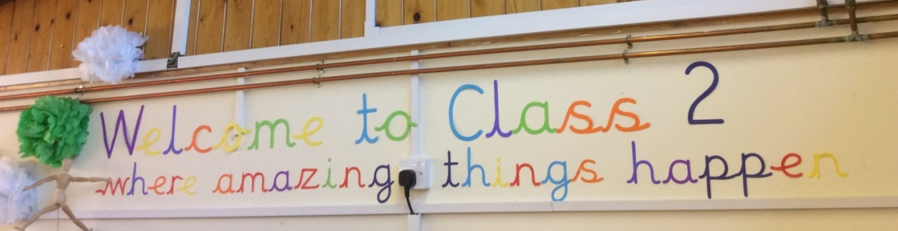
Hello and welcome (back) to Class 2!
Teachers Mrs Robertson (Monday, Tuesday, Wednesday)
Mrs Gray (Wednesday, Thursday, Friday).
Teaching Assistants Mrs Cave & Mrs Dickinson
Year 3 and Year 4
Welcome Meeting
Autumn 2022

Slide 3
Class Contract
On our first day back to school, we have worked together to create a classroom contract.
As well as our Class Contract, we also discussed our Christian Values at Broomhaugh.
Respect
Truth
Kindness
Forgiveness
Thankfulness
Year 3 and Year 4
Welcome Meeting
Autumn 2022

Slide 4
The Calm School Code
We promote and encourage this through:
speaking nicely
listening carefully
acting kindly
moving calmly

Slide 5
Individual rewards
We focus on promoting positive behaviour and want to recognise all of the fantastic things the children do. We also want to reward children for being enthusiastic, making the right choices, learning from mistakes and having a go at new things.
Year 3 and Year 4
Welcome Meeting
Autumn 2022
Weekly:
Special people certificates
Good News postcard
Daily:
Raffle tickets

Slide 6
Class rewards
Children can earn points for their whole class.
Each point is worth a cube.
When the jar is full the class can then bank 15 minutes of ‘Privilege Time’ to enjoy at an agreed time.
Children can choose to do a whole range of things during this special privilege time.
Year 3 and Year 4
Welcome Meeting
Autumn 2022

Slide 7
Reading
Promoting a love of reading is at the heart of our school. Reading is an essential tool to access the curriculum, to engage and make sense of knowledge and to explore, question and respond to the world. We provide our pupils with a good range of authors so that they can understand more about the world in which they live through the knowledge they gain from texts.
We work closely with all of our families to ensure this continues at home. We want all of our children to engage with and experience a wide range of texts including fiction, non fiction, newspapers, magazines, e-books etc.
Year 3 and Year 4
Welcome Meeting
Autumn 2022

Slide 8
Reading
Reading diaries and reading books should be brought into class every day. Reading diaries will be checked weekly.
The children will take part in Guided Reading once a week.
Please support your child to read every day. There are so many benefits of shared reading time including fostering the development of listening skills, spelling, reading comprehension and vocabulary as well as establishing essential foundational literacy skills.
Reading should be recorded daily at home in the reading diary. We encourage children in KS2 to become more independent and record their own reading responses in the diary.
Books will be changed as and when required (when signed by an adult in the reading diary).
Year 3 and Year 4
Welcome Meeting
Autumn 2022

Slide 9
PE
Swimming will be on Wednesday afternoons for Autumn Term only.
Outdoor PE will take place on Friday afternoons.
Please make sure children have a labelled PE kit, including their PE shoes (trainers). They need dark shorts, a white t-shirt, a dark jumper/hoody/ joggers and spare socks. This kit should stay in school.
No jewellery to be worn.
Hair needs to tied up.
Tracksuit bottoms / leggings for outside PE.
P.E. is outdoors wherever possible, so please make sure your child is dressed appropriately and has the correct kit at all times.
Year 3 and Year 4
Welcome Meeting
Autumn 2022

Slide 10
Medical information
Medical forms – updated if necessary (asthma, allergies etc).
Please fill in appropriate forms from the office if medication needs to be administered to your child
Year 3 and Year 4
Welcome Meeting
Autumn 2022
Home time/pick up
If there are any changes to usual pick up arrangements, please contact the school via email or phone prior to home time.

Slide 11

Multiplication Tables
Each child in both Year 3 and 4 has a log in for Times Tables Rockstars (available online or as an iPad/mobile app). This is an excellent way for the class to develop their confidence and abilities in times tables, which will also help their progress in Maths.
The more the children practise, the faster their recall. This will support so many other areas of maths so please encourage and support your child to access this frequently as well as practising in other ways (pencil and paper, games, chanting, songs etc)
There will be a Times Tables Quiz every Friday (this will not start till the week beginning 18th September). More details will follow.
In June 2024, our Year 4 children will take the Multiplication Tables Check. This is a statutory assessment. The children will access the check on an iPad, There will be 25 questions in total (6 seconds to answer each question) taken from a range of tables up to 12 x 12.
Year 3 and Year 4
Welcome Meeting
Autumn 2022

Slide 12

Rise and Shine
Morning Activities
We start each day in Class 2 with a variety of skills based activities which includes:
times table practice
spelling/handwriting
guided reading
journal writing
Year 3 and Year 4
Welcome Meeting
Autumn 2022

Slide 13


Spellings
Spellings will be given out each Monday.
Completed spelling sheets should be signed and returned the following Monday morning ready for our spelling test.
As well as filling in the spelling sheet, please explore other engaging ways for your child to practise their spellings such as chanting, chalking outside, on whiteboards, School 360 (Spell Blast) etc.
Year 3 and Year 4
Welcome Meeting
Autumn 2022

Slide 14
How you can help…
Read with your child daily. Explore a variety of texts: fiction, non fiction, poetry etc.
Ask questions about the book they are reading and encourage them to read with expression.
Continue to practise times tables.
Practice of weekly spellings.
Encourage writing for various purposes and audiences e.g. diary, birthday cards, emails to family and friends etc, concentrating on grammatical accuracy.
Year 3 and Year 4
Welcome Meeting
Autumn 2022

Slide 15
School Website
The school website is a great place to find out about:
Diary dates
Year 3 & 4 class pages including curriculum overviews, optional learning menus, multiplication tables etc
Photos
Newsletters
Year 3 and Year 4
Welcome Meeting
Autumn 2022

Slide 16
Additional information
PE bags are to remain in school and must be in a draw string bag due to space limitations in school.
Book bags or small school bags as our corridor space is very limited.
Children will need wellies to go on the grass in all weathers.
Coats for all weathers – you just never know!
Named water bottles and a piece of fruit for morning snack
Please name all uniform including shoes and wellies
Year 3 and Year 4
Welcome Meeting
Autumn 2022

Slide 17
Questions
If you have any queries, please don’t hesitate to contact us.
We will be at the classroom door at home time at 3:15pm every day. Please feel free to call or E-mail school admin@broomhaugh.northumberland.sch.uk
and one of us will respond as soon as possible.
Thank you for your continued support.
Mrs Gray, Mrs Robertson, Mrs Cave & Mrs Dickinson
Year 3 and Year 4
Welcome Meeting
Autumn 2022

