Slide 1
Class 1 Welcome Presentation (Year 1/2)

Slide 2
Introductions
Teacher – Mrs Errington
Teaching Assistants –
Miss Dobson (Full Time)
Sarah (Monday, Wednesday and Friday)
Mrs Coles (Monday, Wednesday, Friday Mornings. All day Tuesday and Thursday)

Slide 3
Class 1 Ethos
Our ethos is for learning to be fun, active, imaginative, challenging and inspiring and this incorporates a wide range of practical, outdoor, creative, play-based and online learning styles.
The important transition from the Early Years to the National Curriculum is well catered, giving the children opportunities to carry on learning through play.
The transition experience for all of our children is carefully considered so that they have the best opportunities as they move into the next stage of school life!

Slide 4
Shine Bright in Class 1
Benefits of Mixed Age Classrooms:
Allows the teacher to develop a deeper understanding of a pupil’s strengths and needs and provide individualised teaching.
Socially, pupils enjoy mixed-class groups and love growing in stature across the two years.
Older children have the opportunity to serve as mentors and to take leadership roles and younger pupils are able to accomplish tasks they could not do without the assistance of older children.
Pupils develop a better sense of familiarity with their classmates and learn to mix with a wide range of age groups from a young age.

Slide 5
Calm School Code This is consistently reinforced in school
SPEAK NICELY
LISTEN CAREFULLY
ACT KINDLY
MOVE CALMLY

Slide 6
Rewards
We focus on promoting positive behaviour for learning and want to recognise all of the fantastic things the children do. The following are the reward systems we use in class:
Daily
Star Chart (please see following slide for the rewards available for stars)
Stickers and super work stampers
Name on happy face
Weekly
Celebration Assembly
Golden time
Name in the Super Star box (name picked out Friday-prize chosen)

Slide 7
Star Rewards Chart Star rewards can change throughout the year following a discussion with the children.

Slide 8
PE and Forest School
Class one have PE on a Monday and Thursday.
Please make sure children have labelled PE kits including their shoes. They need shorts, a t-shirt and plimsolls. The kit should stay in school.
Please can they also have named tracksuit bottoms/ leggings for outside PE as much of our P.E. as possible is outdoors so please make sure your child is dressed appropriately and has the correct kit at all times.
Hair needs to tied up.
Forest School
Summer Term 1 – Class 1 will take part in Forest School every Thursday afternoon.

Slide 9
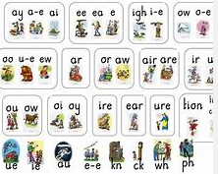
Phonics
Phonics will be taught each morning from 9am – 9:20am and will be taught using the Read Write Inc Scheme.
Children have been split into 4 groups after taking into consideration their year group and importantly their end of year teacher assessment result from July 2022 and most recent Read Write Inc assessment.
Each group will work through the appropriate phonics phases at a pace and in a teaching style appropriate to that group.
Teaching methods will include flashcards, green and alien words, online interactive games and whiteboard work.
Please refer to the “useful websites and documents to support” page for an overview of the phonics phases and what is taught within each. Set 1 has already been taught in Reception and they have been introduced to some of the Set 2 sounds.

Slide 10
KS 1 SATS and Phonics Check
In June, Year 1 will have their end of year Phonics Screening Check.
In May the Year 2 children will take SATs in:
• Reading
• English grammar, punctuation and spelling
• Maths.
SATs have to be carried out during May, but dates aren’t set nationally; this is a school decision. Children are used to the routine of booklets and working in small groups – so there is no stress!

Slide 11
Helping at home
We strongly believe at Broomhaugh that a strong home-school connection will set the stage for a child who will grow up with a love for learning. When parents and teachers work well together, everyone benefits. Parents and teachers can provide each other with unique insight and different perspectives about the same child, culminating in a more complete understanding of that child, their abilities, strengths, and challenges.
So how can you help…?
Read with your child daily. Encourage reading a range of texts – reading book, library, longer texts etc. Record reading in their reading records. Encourage expressive reading and model this if necessary for your child. Don’t forget to ask questions about the book they are reading.
Practise Weekly Spellings (using the Look, Say, Cover, Write, Check sheet given to your child). The children will have a weekly spelling quiz where the focus is on their application of the spellings learnt during the week.
Further information on the next slides…

Slide 12
Reading
We love to read and promoting a love of reading is at the heart of our school, it underpins so many areas of learning and helps all children to access and develop so many other skills. We want to work closely with all of our families to ensure this continues at home. We want all of our children to engage and experience a wide range of texts including fiction, non fiction, newspapers, magazines, e-books etc.
Reading books can be changed on a Monday and Thursday each week. If you child has finished their reading book, they should put it in our reading book box and we will change it on one of the allocated days. Books should be read a number of times to increase the children’s fluency when reading and you should ask your child questions about what they have read. Becoming a competent reader requires good understanding as well as simply being able to decode the text or read the words. We want to foster a love of ‘reading for meaning and enjoyment’.
The children will be read with at least twice a week – once during Guided Reading and they will have one additional reading slot. Please ensure your child's reading book is in their book bag everyday so we can read with them.
Please support your child to read every night. Whilst many children are confident readers already, reading aloud is an important skill to practise and sharing books and stories, discussing characters, plots and facts are all important parts of developing a good understanding of reading as well as the technical skills, not to mention sharing books together is a lovely thing to do. Don't forget to read to your child too, this helps to model expression and listening to others reading is also a really fun and useful things to do.
We will use an assessment of their comprehension to decide whether they are ready to progress to the next book band colour in our scheme.

Slide 13
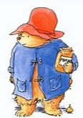
Reading Scrapbook
Please write a comment in the scrapbook to celebrate your child’s reading.
Pictures (from the internet) or drawings of authors of good books they have read
• Pictorial or written book reviews made when a book is finished
• Photos of children visiting any place that features print
• Drawings of characters from books
• Free book marks you get from book shops
• Drawings of front covers of favourite books from home
• Pictures of library visits
• Letters/emails received that involve your child e.g. from a family member or the
tooth fairy!
• Copies of illustrations from books
• When your child has enjoyed listening to a bedtime story and can talk about it they
could record this in their book.

Slide 14
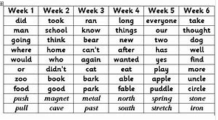
Weekly Spellings
Your child will receive a set of spellings to learn each Friday on a Look, Cover, Write, Check sheet. They will have a spelling assessment of those words the following Friday. Please ensure your child has their spelling folder with them each Friday so we can give them their new spelling sheet.
The spelling rule for that week is taught in school. They have:
20 - 30 minutes to work on their Weekly Spellings in preparation for the Spelling Test on a Friday.
20 - 30 minutes to work on the Common Exception Words for their year group (words which they are expected to read and spell by the end of the year that do not follow traditional phonetic spelling patterns) or 100 Key Stage 1 High Frequency Words. (A copy of these are at the back of the reading scrapbook).

Slide 15
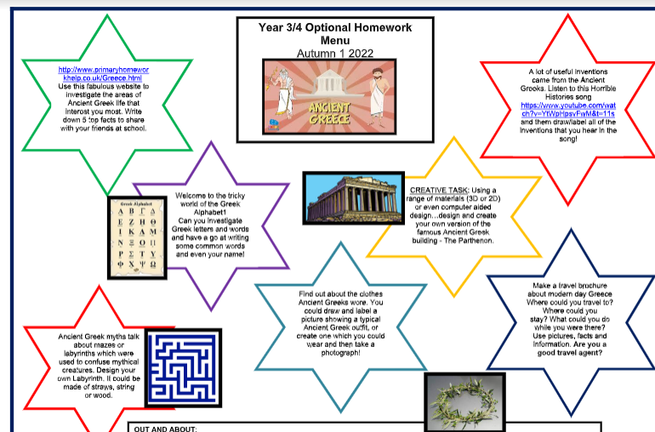
Homework
Each child will been given an homework book and within this is an optional homework menu. They are given a menu every half term. Your child will receive a star for each piece of optional homework they complete during that half term and it will be acknowledged and celebrated in school.
Homework books can also be used as a reading scrapbook. Anything you have read with your child can be added to this e.g. leaflets, magazines etc. There is further information about this in your child’s homework book.
If you child has completed a piece of optional homework they should bring their homework book into school on a Wednesday. On Wednesdays we have an allocated time to discuss and celebrate any homework completed.

Slide 16
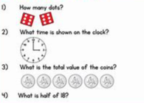
Maths
Practise letter formation (children struggled to form them the correct way)
Practise counting back and forwards in 10’s, 5’s, 2’s and eventually 3’s and 4’s and then times tables! Times Tables Blast is fabulous too (within Resources/J2E on School 360).
White Rose 1 minute maths (iPad app)
Reading the time to the nearest hour/ half hour in Year 1 and to the nearest 5 minutes in Year 2.
Count money
Number problems: “You have 20 sweets and I have 11. How many altogether?”

Slide 17
Handwriting
Encourage your child to write in the precursive style being taught in class. The precursive alphabet is below for your reference. Those children who have mastered this will be encouraged to fully join!

Slide 18
Positive Mental Health
It is really important to us that we support your child to learn, develop and grow in a positive environment where they feel safe and happy (particularly after this most unusual time). We don’t just want to do this academically (although that is of course immensely important to us), but also emotionally and socially. This year is a fantastic opportunity for the class to develop new friendships, improve their self-confidence and build on their ability to face new situations with boldness and excitement.
Personal, Social, Health and Ecomonic Education (PSHE) is timetabled weekly.
The Thrive Approach to education (which promotes children’s positive mental health) will also be an important part of the PSHE delivery in school.

Slide 19
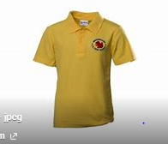
Additional information
Named school uniform including shoes and plimsolls.
Remember wellies to go on the school field.
Children are asked to get letters out of their own bags in Class 1. Alternatively you can hand any letters etc to us on the yard or to the school office.
Coats for all weather.
No toys to be brought into school.
Names water bottles
A pair of waterproof trousers (for outdoor learning)

Slide 20
School Website
Diary Dates, Calendar
Year 1/2 page including Curriculum Overview
Timetable
Photo Galleries
Thrive, mental health and well-being
Newsletters
Staff and Governor information
E-Safety information
Policies …. and lots more!

Slide 21
School Office
Please contact the school office for any of the following:
Squirrels information, booking requests, cancellations, cash/cheque payment and billing related queries.
Medical updates for your child, changes to medication, short-term medication arrangements.
Medical/dental appointments for your child that are during the school day.
Absence reporting
Changes to pick-up arrangements
To request an appointment with the Class Teacher/s

Slide 22
We are always here…..
If you ever have any questions or queries please don’t hesitate to ask.
If you just want to pass on a quick message, the Class 1 team will be available to speak to you from 8:50am each day and then again after school.
Email the school office and I will give you a telephone call.
It is very important to us that the children and their families in Class 1 feel supported and we maintain good communication at all times.

Slide 23
Thank you for your ongoing support!

