Slide 2
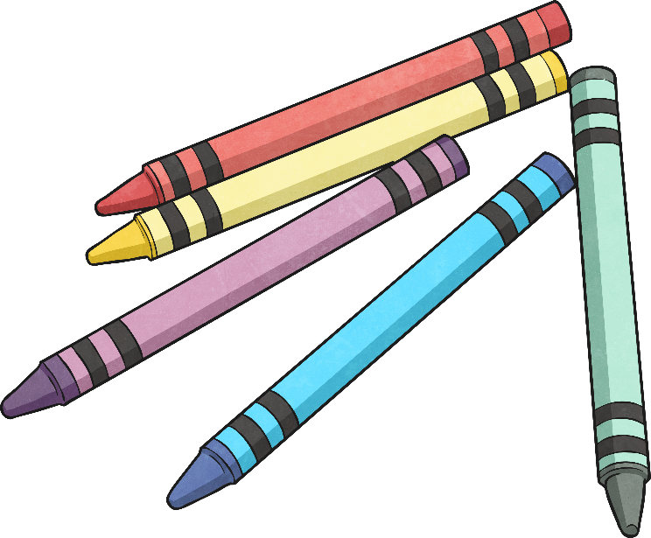
The Day the Classroom Rebelled
The following letters have been inspired by the book: ‘The Day The Crayons Quit’ by Drew Daywalt
Everyone we know has feelings. No matter who we are, we all feel better when we know that we belong. Well, what if I told you that everything in this classroom has feelings too? Yes, the pencils, the books, the rubbers, the sharpeners, even the glue sticks and chairs! They’ve written us some letters to tell us how they’re feeling.
Let’s take a look at what they have to say…

Slide 3
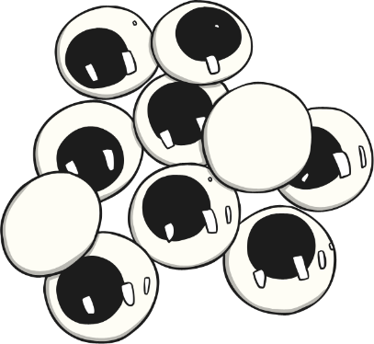
Dear Class 1,
Hi there!
My name is Mr Glue Stick and I am very, very upset!
Look, every time you finish using me I just get thrown back into a basket and no-one really cares about keeping me tidy. I like to keep myself tidy you know!
Some of you spread me all over the page and it gets very messy. And do you know what really hurts the most? Some of you wind me up too far and I go everywhere!
I don’t mind it when you use me all the time but it really makes me sad when you lose my hat (my lid). My mum and dad bought me that hat and without it, not only will I dry up but they will get very angry with me. You wouldn’t want your poor friend getting in trouble, would you?
I like that you use me, but please be more careful.
Yours sincerely,
Your friend,
Mr Glue Stick

Slide 4
Dear Class 1,
How are you all going today? Busy little bees I see.
As you know, I am the life of the party in this classroom…well, for writing tasks at least. Yes, you’ve got it. I’m Mr Pencil!
I like to think of myself as a happy, bright and understanding type of character. I love being such a big part of all your masterpieces - your writing, spelling and even your amazing works of art.
However, I need to let you in on some little problems that have been happening lately. You all seem to be getting slightly confused about which end of me needs to be sharpened. I’m getting shorter and shorter, yet sharper and sharper! As well as leaving me feeling quite bare, I’m sure it’s not safe for you to have me sharpened at both ends. Ouch!

Slide 5
Oh, and one more thing. I didn’t know we had a new class pet. Is it a dog? Or a mouse? My ends seem to be getting chewed up and I feel very wet and slimy. Whoever is doing it, can you please tell them to stop? I really don’t like feeling this way. It’s rather uncomfortable.
I do love that you use me as much as you do and I can tell that I’m really important, but please stop sharpening me at both ends. Oh, and please don’t forget to tell our new class pet, or whoever is chewing me, that I am not a chew toy!
Anyway, see you again soon,
Love from Mr Pencil

Slide 6
Dear Class 1,
It’s me! Mr Library Book.
I have been on so many holidays lately. I have been here, there and everywhere. I have been to so many of your houses and I have seen all of your family members. I have seen so many weird and wonderful things. You have taught me a few things and I hope I have taught you a thing or two as well.
However, when I come back home to the library, I really love spending time with my friends and family. Our friend the librarian always puts me back with them, but sometimes when you need a quick book to read, you don’t put me back in the right place.
I don’t like being mixed up with all the other books. I feel like I get split up from my friends and family and it’s only the librarian and teachers who care about where I belong. I am like you - I have a home you know!
It’s great that me and my friends can teach you all the things you need to know, but at the end of the day, I like to relax and spend time with my friends and family. Please put me back in the right place.
Love from your friend,
Mr Library Book

