Slide 2
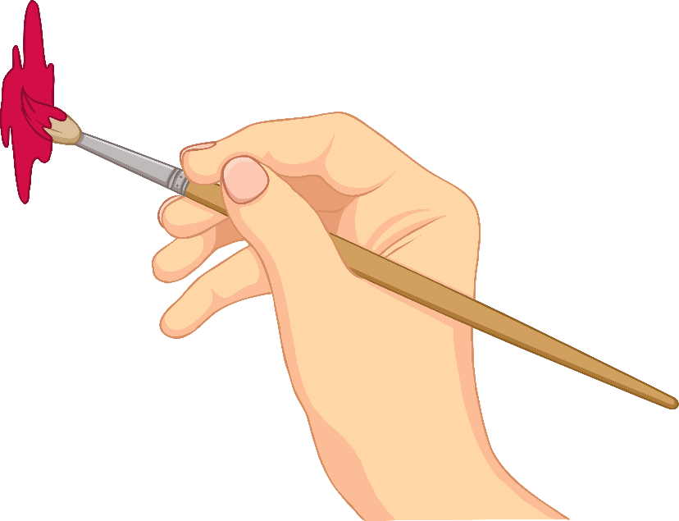
Fact File
Name: Giuseppe Arcimboldo
Born: 1527 (nearly 500 years ago!)
Where: Italy
Job: Artist who made paintings

Slide 3
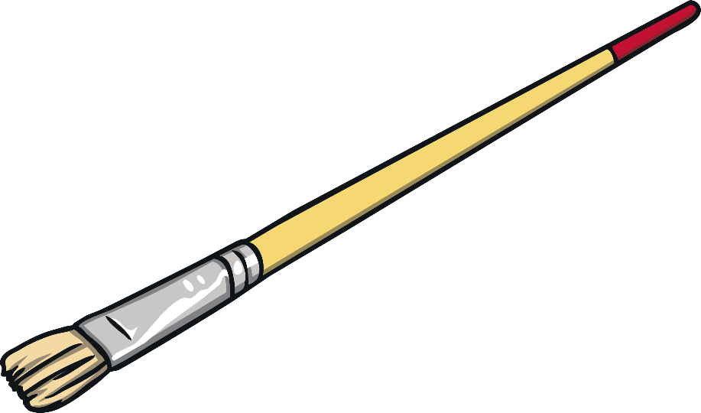
What Did He Paint?
Giuseppe Arcimboldo is well known today for painting portraits of people made out of different types of fruits, vegetables, meat and fish.
He would pick food that had a connection to whatever he was painting. For example, when creating a picture of autumn he used fruits and vegetables that grew in autumn.

Slide 4
Spring
Photos courtesy of ‘Ken and Nyetta’ (@flickr.com) – granted under creative commons licence - attribution

Slide 5
Summer
Photos courtesy of ‘Ken and Nyetta’ (@flickr.com) – granted under creative commons licence - attribution

Slide 6
Autumn
Photos courtesy of ‘Ken and Nyetta’ (@flickr.com) – granted under creative commons licence - attribution

Slide 7
Winter
Photos courtesy of ‘Ken and Nyetta’ (@flickr.com) – granted under creative commons licence - attribution

